Slide 1
Endometriosis
Dr Fulufhelo Tshivhula
Specialist Gynaecologist
Polokwane
62 Burger street
015 291 4310

Slide 2
What is Endometriosis
Endometriosis is a chronic disease where tissue that resembles the lining of the womb (uterus) is found elsewhere in the body

Slide 3
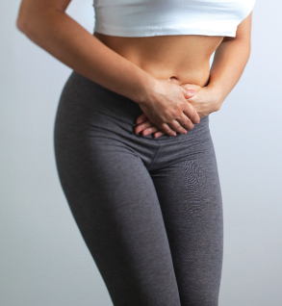

Slide 4
Endometriosis
Endometriosis occurs when tissue similar to that which lines the inside of the uterus implants outside the uterine cavity.
The endometrial growths respond to menstrual hormones in the same way as the uterine tissue, by building up, breaking down and then shedding.
Since the tissue has no means of being expelled from the body, it develops into painful cysts or nodules at the areas of implantation.

Slide 5
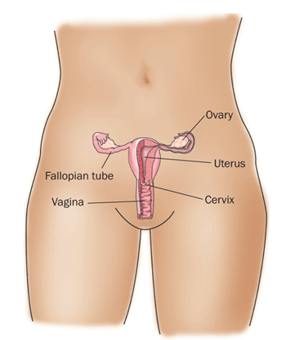

Slide 6
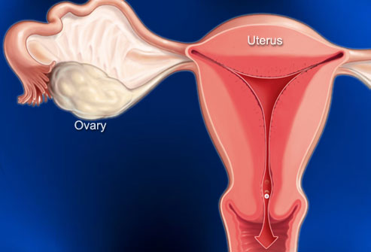

Slide 7
Endometriosis Symptoms
Pain just before, during, or after menstruation is the most common symptom of endometriosis.
Pain may be disabling and may occur during or after sex, or during bowel movements or urination.
It sometimes causes chronic pain in the pelvis and lower back.
However, many women with endometriosis have mild or no symptoms.
Symptoms may be related to the location of the growths.

Slide 8
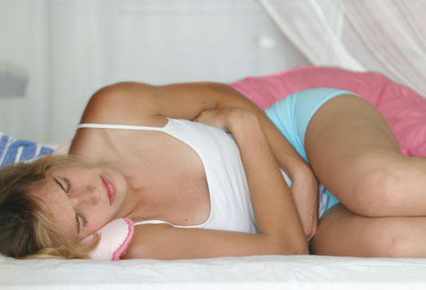

Slide 9
The symptoms may vary widely between women, ranging from pain, usually around menstruation, to infertility.
The degree of symptoms does not always correlate with the severity of the disease.

Slide 10
Endometriosis thinks of
Painful Periods
Heavy Periods
Pelvic Pain
Painful intercouse
Infertility

Slide 11
Other symptoms that can be
lower abdominal pain,
diarrhea and/or constipation,
low back pain,
chronic fatigue
blood in the urine.

Slide 12
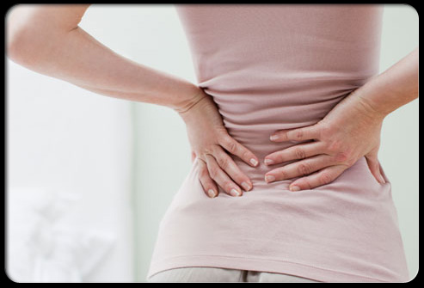

Slide 13
What causes endometriosis?
The cause of endometriosis is unknown.
Retrograde Mensturations
Coelomic metaplasia
Iatrogenic Disseminations
Familial and Genetic
Race

Slide 14
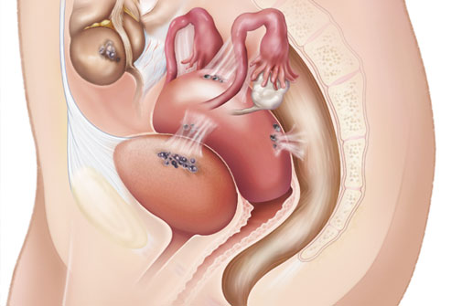

Slide 15
Endometriosis is the abnormal growth of cells (endometrial cells) similar to those that form the inside of the uterus, but in a location outside of the uterus.
Endometriosis is most commonly found on other organs of the pelvis

Slide 16


Slide 17
Who is affected by endometriosis
Affects women in their reproductive years.
The exact prevalence of endometriosis is not known, since many women may have the condition and have no symptoms.

Slide 18
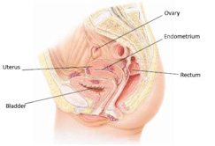

Slide 19
Symptoms of PMS
PMS can trigger a wide range of aches and pains, including:
Back pain
Headaches
Tender breasts
Joint pain

Slide 20
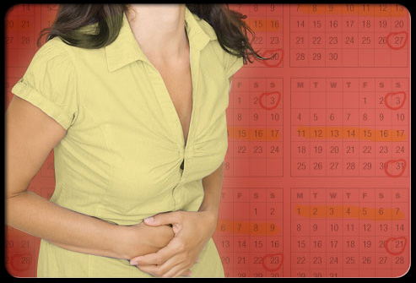

Slide 21
How does it causes pain
The endometrial tissue respond to normal cycle hormones and the also menstrurate
In the ovary it forms a cysts called endometrioma

Slide 22
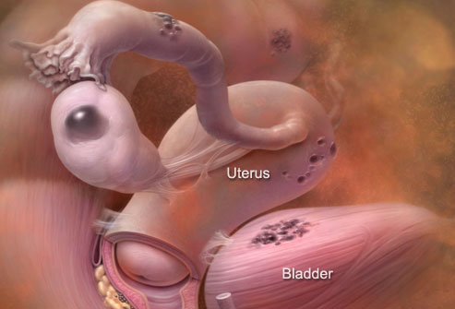

Slide 23
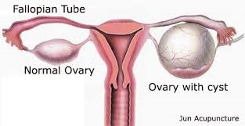

Slide 24
Heavy Period
Enlarge womb ( Adenomyosis)

Slide 25
Dyspareunia
Adenomyosis
Recto –vaginal- Nodules

Slide 26
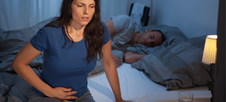

Slide 27
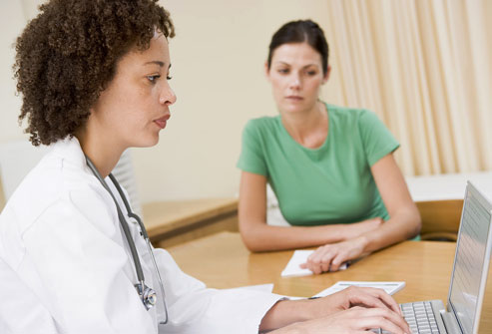

Slide 28
Diagnosis: Tracking Symptoms
Your pattern of symptoms can help to identify endometriosis, including:
When the pain occurs
How bad it is
How long it lasts
A change or worsening of pain
Pain that limits your activities
Pain during intercourse, bowel movements, or urination

Slide 29


Slide 30
Pelvic Exam
Dr will perform a pelvic exam to check the ovaries, uterus, and cervix for anything unusual.
An exam can sometimes reveal an ovarian cyst or internal scarring that may be due to endometriosis.
Dr also looks for other pelvic conditions that could cause symptoms similar to endometriosis

Slide 31
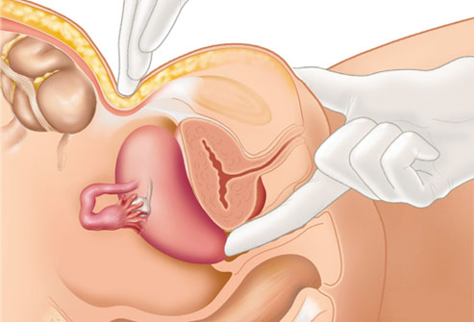

Slide 32
Pelvic Scans
Although it isn't possible to confirm endometriosis with scanning techniques alone,
Ultrasound ( SONAR),
CT scan, or MRI to help with diagnosis.
These may be able to detect larger endometrial growths or cysts.

Slide 33
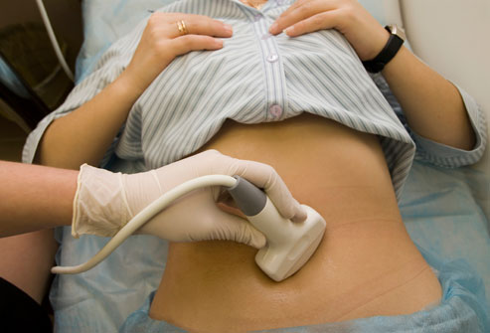

Slide 34
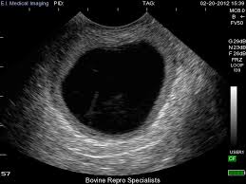

Slide 36
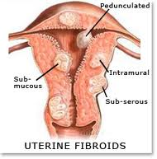

Slide 37
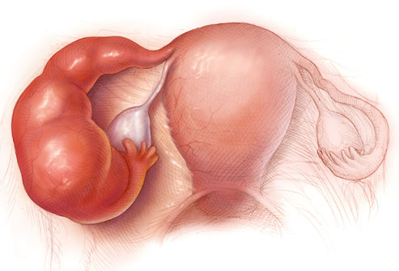

Slide 38
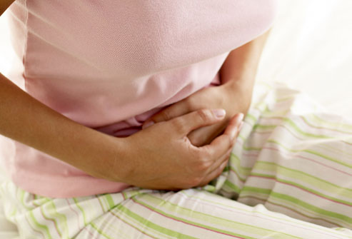

Slide 39
Common types endometriosis
Peritoneal endometriosis,
Ovarian endometriosis
Recto-vaginal endometriosis.

Slide 40
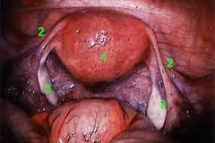

Slide 41
IS Endometriosis cancerous
NO

Slide 42
IS Endometriosis Infectious
NO

Slide 43
Pregnancy
Women are often advised not to postpone pregnancy, as the more the disease progresses, the more likely it is to cause infertility.
Encouraging women to fall pregnant can be difficult, as this is a highly personal and life-changing decision.
Genetic links to endometriosis may also play a role, as women could pass on the risk to their babies.
Pregnancy often causes a remission of endometriosis, as ovulation ceases, causing the growths to shrink.
It can return after pregnancy

Slide 44
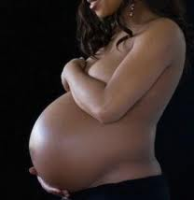

Slide 45
Infertility
Abnormal hormonal function,
Infrequent intercourse (pain),
Affected sperm transportation,
Tubal blockage,
Ovarian damage following surgical treatment.

Slide 47
Is there a cure for endometriosis
NO
Currently there no cure but there is variety of treatments which can lessen the problems

Slide 48


Slide 49
Prevention
Endometriosis cannot be prevented, especially if there is a family history of the disease.
Using oral contraceptives may reduce the risk of developing endometriosis or prevent it from becoming worse.
Although lifestyle modification and certain nutritional supplementation have been suggested to improve the symptoms of endometriosis,r use.
Pregnancies maybe protective in some women.

Slide 50


Slide 51


Slide 53
Just Cramps or Endometriosis?
Most women have some mild pain with their menstrual periods.
They may get relief from over-the-counter pain medications.
If your pain lasts more than two days, keeps you from doing normal activities, or remains after your period is over, you should consult your doctor.
Endometriosis also may cause pain in the lower back.

Slide 54
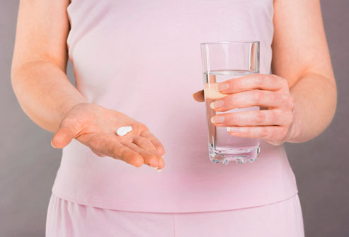

Slide 55
How is endometriosis treated?
The goals of endometriosis treatment may include
Pain relief and/or
Enhancement of fertility

Slide 56
Decision is base on
Fertility
Not for Fertility
Surgical intervention
Laparascopy
Medical
Hormones Treatments

Slide 57
Medical treatment of endometriosis
Nonsteroidal anti-inflammatory drugs or NSAIDs (such as ibuprofen or naproxen sodium) are commonly prescribed to help relieve pelvic pain and menstrual cramping.

Slide 58
Birth Control Pills
Oral contraceptives manage your levels of estrogen and progestin,
It make your menstrual periods shorter and lighter.
That often reduces the pain of endometriosis.
Progestin-only therapy can also be given by injection.
Endometriosis symptoms may return after you stop taking the pills.

Slide 59
Hormonal Medications
Combine oral contraceptives
Provera

Slide 60
Surgical treatment of endometriosis
Laparascopy
Laparatomy

Slide 61
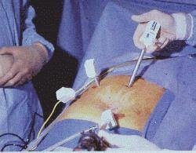

Slide 62
Excision
During a laparoscopy, the surgeon may remove visible endometrial growths or adhesions.
Most women have immediate pain relief.
However, a year after the surgery, about 45% of women will have a recurrence of symptoms.
The likelihood of recurrence increases over time.

Slide 63
Gonadotropin-releasing hormone analogs (GnRH analogs
These drugs mimic menopause, eliminating periods along with endometriosis symptoms
The side effects
hot flashes, vaginal dryness, irregular vaginal
bleeding,
mood changes, fatigue, and
loss of bone density (osteoporosis).

Slide 64
Progestins
Side effects
Absent of mensturations
breast tenderness,
bloating,
weight gain,
irregular uterine bleeding, and
depression.

Slide 65
Surgical
Laparascopy
Laparatomy

Slide 66
Laparoscopy
Laparoscopy is the only sure way to determine if you have endometriosis.
Dr inflates the abdomen with gas through a small incision in the navel.
A laparoscope is a viewing instrument that's inserted through the incision.
The surgeon can take small pieces of tissue for examination in a lab -- called a biopsy -- to confirm the diagnosis

Slide 67
Hysterectomy
Hysterectomy and removal of Ovaries will definatly cure the problems

Slide 68
Menopause
Generally, the onset of menopause usually results in the decrease of endometriosis.
However, severe endometriosis can be reactivated by hormone replacement therapy or continued hormone production after menopause.

Slide 69
Coping With Endometriosis
Although there is no way to prevent endometriosis,
You can make lifestyle choices that will help you feel better.
Regular exercise may help reduce pain by improving your blood flow and producing endorphins, the body's natural pain relievers.

Slide 70
Key
Woman really need to take care of themself

Slide 71
